Slide 1
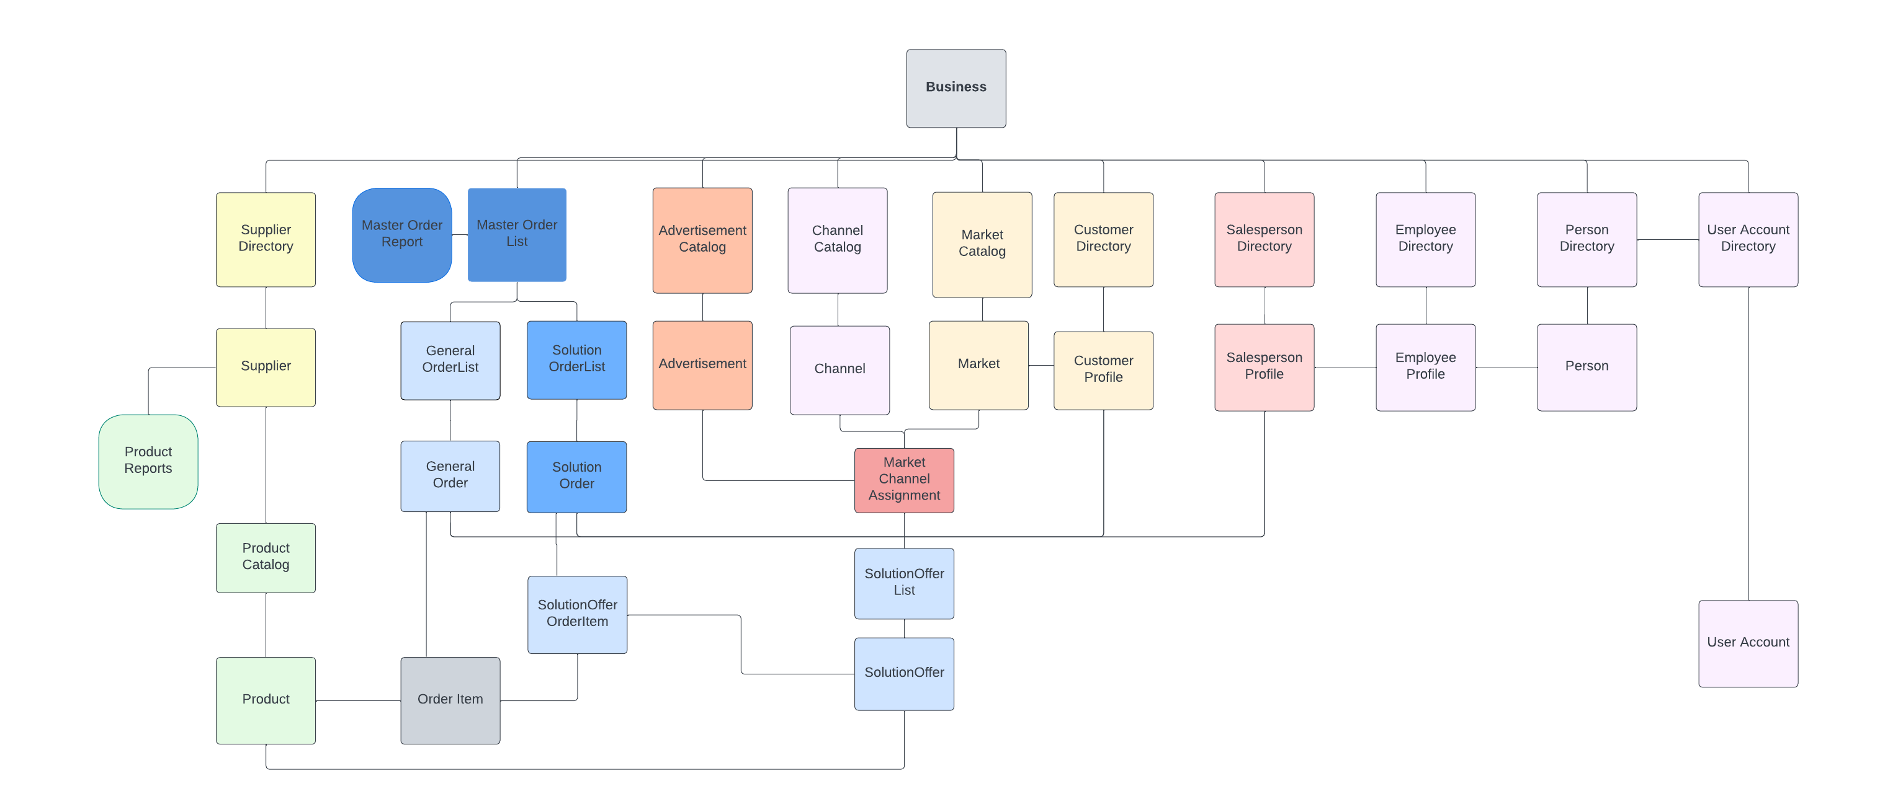
Structure : UML Model

Slide 2
Logic : Sales Analysis
Sales Analysis
1. Revenue : total sales
2. Performance Rate : # of Above Target Order / # of Total Order
3. Profit : sum of (acutal price - target price
4. Net Profit : Profit – Advertisement Budget
* SolutionOrder devides it’s actual price to each OrderItem depending on each price’s target price ratio
ex. A, B, C Product price is $1, $3, $5
-> SolutionOrder’s OrderItem (A, B, C) $18 devides into OrderItems with $2, $6, $10
* Advertisement Budget depends on MarketChannelAssignment of the Advertisement

